Slide 1

Spring Core Profiles
Trey Howard
Senior Consultant
http://www.linkedin.com/in/treyhoward
Source Code:
https://github.com/CinJug/spring-profiles
Pinnacle Solutions Group
http://www.pinnsg.com

Slide 2
What is Spring
Inversion of Control (IoC) Container
Dependency Injection (DI)
Hollywood Principle: “Don't call us, we'll call you”

Slide 3
Why Spring?
Separation of Concerns: Promotes strong interfaces
Promotes testable code: Integrates with mock frameworks
Aspect-Oriented Programming (AOP): Transaction advice, Auditing, etc
Full Java stack: Web Services, MVC, Webflow, JDBC Template, JMS Template

Slide 4
Before / After
Instead of:
Foo foo = new Foo()
Do this:
@Autowire
Foo foo;
public void setFoo(Foo foo) {...}

Slide 5
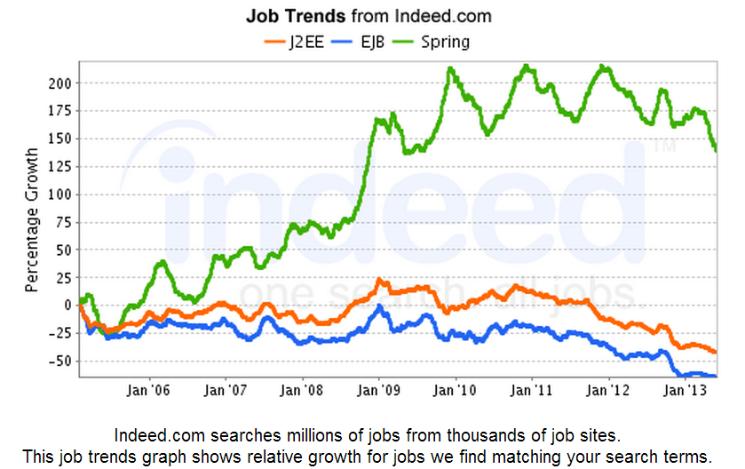
Why Spring? (cont'd)
Market demand:

Slide 6
Real World Example
Distributed application with multiple applications, databases, and message queues
Developing a new application that is a small slice of the overall landscape and need to allow developers to run on their workstation

Slide 7
Challenges
While each workstation has its own queue, the dev database is shared by all workstations (and “real” dev!), creating a race condition.
Due to the complexity of the system architecture (integration with legacy systems, etc), it's not practical to replicate the database for each workstation.
But what if we could isolate the event processing logic and put it in its own database?

Slide 8
Workflow
SQL Trigger on customer table creates an event record when name/zip updated (status=incomplete)
MainStart polls the event table for incomplete events and publishes to the processing queue (status=pending)
MainComplete consumes the processing queue and queries the customer (status=complete)

Slide 9
Dev Environment
CustomerService
EventService
CustomerDao
EventDao
Dev
Processing
Queue
SpringDemo

Slide 10
Workstation Environment
CustomerService
EventService
CustomerDao
EventDao
Quarantined
Processing
Queue
SpringDemo
Quarantined
SpringDemo

Slide 11
Multiple Databases
The event is first processed in dev, but we can write a procedure to clone those events into our workstation database.
Note that when the event is processed in the workstation database, it still queries the dev database for customer information.

